Slide 1
Offerors’ Presentation July 15, 2022
U.S. Probation & Pretrial Services Office
Northern District of Texas

Slide 2
Welcome
Presentation Goal
Provide information necessary to submit a Request for Proposal (RFP)
Presentation Objectives
Introduce U.S. Probation & Pretrial Services Office (USPPSO)
Review Sections A-M of the RFP
Answer Questions

Slide 3
USPPSO Mission
Assist Federal Courts in the fair administration of justice;
Protection of the community; and
Bring about long-term, positive change to Persons Under Supervision (P\S)

Slide 4
USPPSO Main Functions
Pretrial Services
Presentence Investigations (Court Services)
Post-Conviction Supervision

Slide 5
Blanket Purchase Agreements (BPA)
The agreement in which services will be rendered; a “charge account” arrangement between our office and a vendor(s) for recurring purchases of services.
Some BPAs may have multiple vendors. Services (referrals) will be balanced/rotated among vendors.
Awards are made to vendors who are determined to be technically acceptable and who offer the lowest cost (bid).

Slide 6
District BPAs
Substance Abuse Treatment (Residential and Outpatient)
Mental Health Treatment (Outpatient)
Sex Offender Treatment (Outpatient)

Slide 7
Statement of Work Section A
Solicitation/Offer/Acceptance (AO 367)
Complete Blocks 8 through 15
Our office completes the remaining blocks

Slide 8
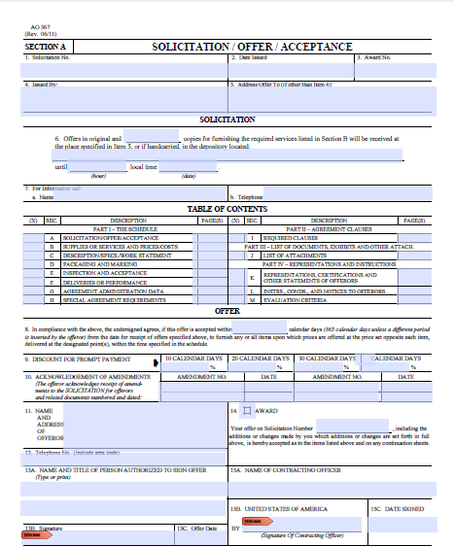

Slide 9
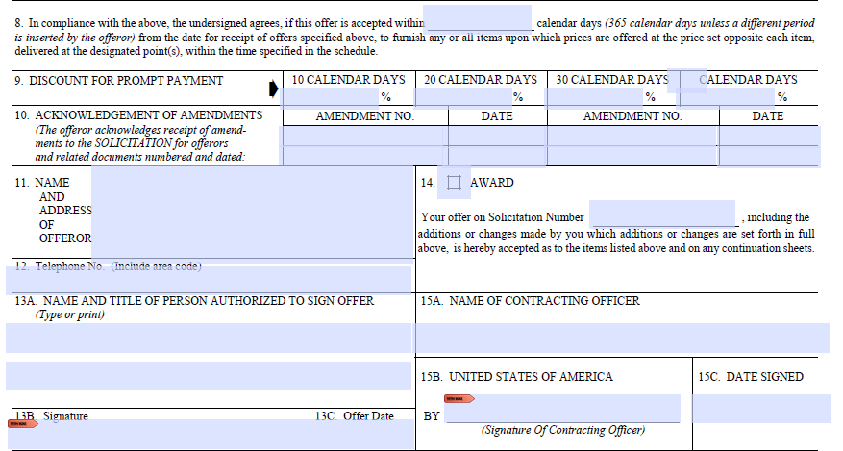

Slide 10
Statement of Work Section B
Supplies or Services & Offeror’s Prices
Page B-1
Catchment Area: Geographic area where services are required to be performed
BPA Duration: Fiscal Year (FY) 2023 in addition to two 12-month option years – not to exceed 36 months

Slide 11
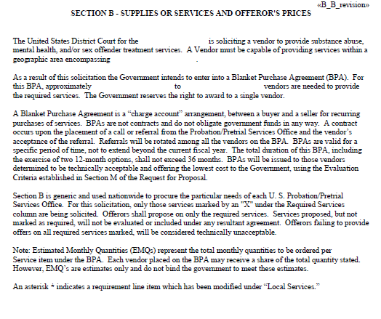

Slide 12
Statement of Work Section B cont.
Supplies or Services & Offeror’s Prices
Page B-2 & beyond
Required Services: All services listed are required
Offerors must submit bids on all required services or the proposal will be considered technically unacceptable
Project Code and Service: The project code is a number associated with a specific service
Estimated Monthly Quantities (EMQ): Aside from new services, the estimated monthly quantities for services are based on historical data
EMQs are estimates and our office is not bound to meet them

Slide 13
Statement of Work Section B cont.
Supplies or Services & Offeror’s Prices
Page B-2 & beyond cont.
Units: Defined in bold under the EMQ column (i.e., 30 minute increments, per intake, per day, or per dose)
Price: Reflects your cost to perform the requirements of the Statement of Work (Section C) as well as all relating terms and conditions of the RFP
Client ‘no shows’ and administrative functions, such as completion of paperwork and phone calls, are not billable and should be included in the unit price
If the service will be performed by a vendor with whom you team (subcontract), enter ‘S’ next to the price and describe the arrangements in Section J

Slide 15
Statement of Work Section C
Provision of Services - Piggybacking
Other U.S. Probation and Pretrial Services Offices, and the Federal Bureau of Prisons, are authorized to use our contracted vendors to provide treatment services to active P\S and inmates residing in local community corrections centers

Slide 16
Local Need Requirements
Requirements the district has added to meet the needs of our P\S
Consult the last few pages of Section C for district local need requirements specific to your BPA(s)

Slide 17
Local Need Requirements
The vendor's services are made available during the weekday (from 9:00 a.m. until 5:00 p.m.) and 2 evenings per week (from 5:00 p.m. until 9:00 p.m.).
The vendor shall operate a code-a-phone system for random urine collections and schedule urine collections from 10:00 a.m. to 8:30 p.m., Monday through Friday, and 12:00 p.m. to 5:00 p.m., on Saturday, Sunday, and holidays.
The vendor must have restrooms that allow for the direct observation of defendant/offender voiding. If the collector does not have a direct view, a mirror must be installed which allows for the direct observation of voiding.
The vendor shall provide treatment staff fluent in the Spanish language to ensure that Spanish speaking offenders/defendants receive treatment services. Bilingual treatment services may be provided directly by the vendor’s staff or through a subcontractor.
The physical facility at which services are provided is located on or within ½ mile of public transportation access.

Slide 18
Local Need Requirements Cont. (Group Telemedicine)
The Northern District of Texas is seeking this local need in response to the unique treatment barriers and needs in our district. We would like to use telemedicine when appropriate to achieve these ends. The use of telemedicine is authorized only after vendor and the USPO/USPSO staff the individual client’s case, determine he or she is appropriate for treatment via telemedicine, and it is approved by the district’s contracting officer or designee. The use of telemedicine is for the benefit of the Judiciary and not the convenience of the vendor. The use of telemedicine is not in lieu of the vendor’s ability to provide services in-person when appropriate (see note below).
The vendor is authorized to provide this service via telemedicine, which includes providing health care delivery, diagnosis, consultation, and treatment and the transfer of medical data through interactive audio, video, or electronic/data communications. The vendor must adhere to and meet the same legal, ethical, and confidentiality standards when providing telemedicine. The vendor shall also obtain consent of the client before the delivery of telemedicine services and shall include documentation of the same in the individual’s treatment record.
To ensure confidentiality for each session, the provider shall require that each client verify that he or she is the only person on that line and that no person who is not part of that treatment group is listening. Each participant will also enter into a confidentiality agreement before being allowed to participate in treatment by telephone.
To verify that services were performed, the vendor shall complete the sign-in log with the following information:
•The client’s name.
•Date of the session.
•The time the session began and concluded.
•Confirmation of the means in which the session was conducted (i.e. teleconference, video conference, internet).
The assigned officer will follow up with the client to ensure that the session was completed.
For de-escalation, if an emotionally charged topic was discussed or the client appears emotionally agitated, the provider shall follow up with additional contact later in the day to ensure that the client has successfully de-escalated. The provider shall also remind the client to reach out to his or her social support system at any time.
NOTE: This requirement is not in lieu of the provisions set forth in the Request for Proposals which require the vendor (and any proposed subcontractor) to maintain an acceptable facility located within the defined catchment area.

Slide 19
Local Need Requirements Cont. (Individual Telemedicine)
The Northern District of Texas is seeking this local need in response to the unique treatment barriers and needs in our district. We would like to use telemedicine when appropriate to achieve these ends. The use of telemedicine is authorized only after vendor and the USPO/USPSO staff the individual client’s case, determine he or she is appropriate for treatment via telemedicine, and it is approved by the district’s contracting officer or designee. The use of telemedicine is for the benefit of the Judiciary and not the convenience of the vendor. The use of telemedicine is not in lieu of the vendor’s ability to provide services in-person when appropriate (see note below).
The vendor is authorized to provide this service via telemedicine, which includes providing health care delivery, diagnosis, consultation, and treatment and the transfer of medical data through interactive audio, video, or electronic/data communications. The vendor must adhere to and meet the same legal, ethical, and confidentiality standards when providing telemedicine. The vendor shall also obtain consent of the client before the delivery of telemedicine services and shall include documentation of the same in the individual’s treatment record.
To verify that services were performed, the vendor shall complete the sign-in log with the following information:
•The client’s name.
•Date of the session.
•The time the session began and concluded.
•Confirmation of the means in which the session was conducted (i.e. teleconference, video conference, internet).
The assigned officer will follow up with the client to ensure that the session was completed.
For de-escalation, if an emotionally charged topic was discussed or the client appears emotionally agitated, the provider shall follow up with additional contact later in the day to ensure that the client has successfully de-escalated. The provider shall also remind the client to reach out to his or her social support system at any time.
NOTE: This requirement is not in lieu of the provisions set forth in the Request for Proposals which require the vendor (and any proposed subcontractor) to maintain an acceptable facility located within the defined catchment area.

Slide 20
Mandatory Requirements
Required services and related standards
Consult Section B for project codes and services required for your specific BPA

Slide 21
Urine Collection, Testing, & Reporting (1010)
Store supplies in a secured area
Limit use of lavatory for other purposes
Collect one specimen at a time by direct observation
Follow Chain of Custody protocol
Store and mail positive specimens as indicated in this section
Maintain a Urinalysis Test Log
Collection of specimens by trained staff
*Our office provides all necessary collection supplies. Does not include gloves or any PPE.

Slide 22
Urine Collection, Testing, & Reporting (1010) cont.
Random Urine Collection Procedures (Code-A-Phone)
A three phase program providing clients less than 24 hours notice to submit a specimen
Phase I (minimum 3 tests per month)
Phase II (minimum 2 tests per month)
Phase III (minimum 1 test per month)

Slide 23
Urine Collection, Testing, & Reporting (1010) cont.
Local Need Requirement
The program shall operate a code-a-phone system for random and observed (unless otherwise approved) urine collections using the following schedule:
Monday through Friday - 10:00 a.m. until 8:30 p.m.
Saturday, Sunday, and Holidays - 12:00 p.m. until 5:00 p.m.

Slide 24
Updated UA Log

Slide 25
Substance Abuse Intake Assessment Report (2011)
A comprehensive diagnostic interview, which includes the use of structured instruments, conducted by a state certified addictions counselor or clinician who meets the standards of practice established by the state’s regulatory board
The report includes a diagnostic impression, bio-psycho-social profile, targeted problems, and treatment recommendations, among other items
Forward typed report to the assigned officer within 10 calendar days of the first face-to-face contact

Slide 26
Substance Abuse Services
Individual Counseling (2010) - one (1) client;
Group Counseling (2020) - two (2) or more clients, but no more than twelve (12);
Family Counseling (2030) - a client and one (1) or more family members. The vendor may meet with family members without the client present with USPO/USPSO approval;
Intensive Outpatient Counseling (2080) UPDATE– Will no longer be an option for new contracts- should be individualized treatment based on individual and group sessions after staffed with counselor and USPO

Slide 27
Substance Abuse Services (Staff Requirements)
Principal counseling services practitioners shall have at least one of the following (a or b):
(a) an advanced degree (masters or doctoral level) in behavioral science, preferably psychology or social work, or
(b) a BA/BS and at least two years of drug treatment training and/or experience
Counselors shall be certified and/or have credentials to engage in substance abuse treatment intervention as established by his/her state’s regulatory board and/or accrediting agency
Paraprofessionals are only used under the direct supervision of, and in conjunction with, a staff member who meets the requirements described in item numbers (1) and (2) above, and after obtaining the approval of the contracting officer or designee. Interns may be considered paraprofessionals

Slide 28
Integrated Treatment Services for Co-Occurring Disorders
Individual Counseling (6015) - one (1) client. This treatment shall conform to the standards set forth in 2010 and 6010, but shall be completed in an integrated fashion
Group Counseling (6026) - at least two (2), but no more than ten (10) clients. This treatment shall conform to the standards set forth in 2020 and 6020, but shall be completed in an integrated fashion

Slide 29
Integrated Treatment Services for Co-Occurring Disorders (Staff Requirements)
Practitioners providing integrated treatment services for co-occurring disorders must be a licensed/certified psychiatrist, psychologist, masters or doctoral level practitioner who meets the standards of practice established by his/her state’s regulatory board and are trained in working toward the recovery of clients with co-occurring disorders;
Practitioners use integrated treatment approaches deemed successful with individuals with co-occurring psychiatric and substance abuse disorders;
Practitioners develop a treatment plan which includes: (1) short and long-term goals the defendants/offenders will be attempting to achieve; (2) measurable objectives which relate to the achievement of the corresponding goals and objectives; (3) type and frequency of services to be received; (4) specific criteria for treatment completion and the anticipated time-frame; and (5) documentation of treatment plan review, at least every 90 days, to include the following: defendant’s/offender’s input, continued need for treatment, and information on family and any significant other involvement (i.e., community support programs, etc.)

Slide 30
Treatment Services Requirements
Provide emergency services when counselors are unavailable
Create and update treatment plans, and forward plans to the USPPSO at least every 90 days. (Preparation of treatment plans must be included in the unit price)
Forward typed discharge summary to the USPPSO within 15 calendar days after treatment is terminated
Notify USPPSO within 24 hours of ‘no shows’, violation conduct, and/or third party risk issues

Slide 31
Physical Examination & Laboratory Studies
Laboratory Studies and Report (4020) - Blood and urine testing is conducted when medically necessary. Testing is billed at actual price
Typed report to be submitted to the USPPSO within 15 calendar days after completion

Slide 32
Psychological/Psychiatric Evaluation Testing & Report
Psychiatric Evaluation and Report (5030) - consisting of a medical evaluation and report conducted and prepared by a licensed medical doctor/physician, a psychiatrist who specializes in disorders of the mind, or other qualified practitioner who is board certified or board-eligible, and meets the standards of practice (i.e., academic training, residency, etc.) established by his/her state’s regulatory board. The purpose for this type of evaluation is to establish a psychiatric diagnosis, to determine the need for psychotropic medications and/or to develop an initial treatment plan with particular consideration of any immediate interventions that may be needed to ensure the client’s safety to that of the community.
Typed report to be submitted to the USPPSO within 15 calendar days after completion.

Slide 33
Mental Health Intake Assessment & Report (5011)
Performed by a masters or doctoral level clinician who is licensed or certified and meets the standards of practice established by his/her state regulatory board. The assessment could also be conducted by a non-licensed masters level clinician under the direct supervision of a licensed professional in accordance with state licensing standards
The vendor shall provide:
At least one comprehensive clinical/diagnostic interview utilizing a structured interview tool such as the Structured Clinical Interview for DSM
A typed report shall be provided to the USPPSO within 15 calendar days after the vendor’s first personal contact and must include more than simply a synopsis or overview of presentence and/or pretrial services reports or institutional progress reports provided by the USPPSO to the vendor for background information

Slide 34
Mental Health Case Management Services (6000)
Defined as a method of coordinating the care of severely mentally ill people in the community. Case management services serve as a way of linking clients to essential services including but not limited to securing financial benefits, health and mental health care. This service is only available when used in conjunction with some form of mental health counseling (Project Codes 6010, 6015, 6020, 6021, 6026, 6027, 6028, 6030, 6036, and 6080)

Slide 35
Mental Health Case Management Services (Staff Requirements)
Case Managers meet the standards of practice established by his/her state’s professional regulatory board (where applicable) and meet the minimum qualifications (must have 1 or 2 and 3):
Bachelor’s degree in a behavioral health field (psychology, social work, counseling, etc.) and one year experience in behavioral health field or appropriate internship; or
High School Diploma or GED and five (5) years experience in behavioral health setting; and
Work under the direct supervision of, and in conjunction with licensed/certified psychiatrist, psychologist, or masters or doctoral level practitioner who meets the standards of practice established by his/her state’s professional regulatory board

Slide 36
Mental Health Services
Individual Counseling (6010) - one (1) client;
Group Counseling (6020) - two (2) or more clients but no more than twelve (12);
Family Counseling (6030) - a client and one or more family members. The vendor may meet with family members without the client present with USPPSO written approval

Slide 37
Mental Health Counseling (Staff Requirements)
Conducted by a licensed/certified psychiatrist, psychologist, or masters or doctoral level practitioner who meets the standards of practice to perform psychotherapy/counseling services as established by his/her state’s regulatory board
Emergency services (e.g., after hour phone numbers, local hotlines) shall be available for clients when counselors are unavailable. Emergency telephone calls shall be included in the basic unit prices
Only face-to-face contacts between practitioner and client(s) (or family) are invoiced

Slide 38
Sex Offense-Specific Evaluation & Report (5012)
A sex offense-specific evaluation (also commonly known as a “psychosexual evaluation”) is a comprehensive evaluation of an alleged or convicted sex offender, meant to provide a written clinical evaluation of a defendant’s/offender's risk for re-offending and current amenability for treatment; to guide and direct specific recommendations for the conditions of treatment and supervision of a client; to provide information that will help to identify the optimal setting, intensity of intervention, and level of supervision, and; to assess the potential dangerousness of the defendant/offender. This type of evaluation may include one or any combination of the following services: penile plethysmograph (5021), clinical polygraph (5022), psychological testing (5020), and/or Visual Reaction Time (VRT) Measure of Sexual Interest (5025), and any other assessment deemed appropriate by the clinician and approved in advance by the USPPSO
The vendor shall provide:
A sex offense-specific evaluation and report (5012): for the purposes of assessing risk factors and formulating a treatment program plan. A sex offense specific evaluation of a client shall consider the following: sexual developmental history and evaluation for sexual arousal/interest, deviance and paraphilias, level and extent of pathology, deception and/or denial, presence of mental and/or organic disorders, drug/alcohol use, stability of functioning, self-esteem and ego-strength, medical/neurological/pharmacological needs, level of violence and coercion, motivation and amenability for treatment, escalation of high-risk behaviors, risk of re-offense, treatment and supervision needs, and impact on the victim, when possible.
Typed report to be submitted to the USPPSO within 15 calendar days after completion of evaluation

Slide 39
Sex Offense-Specific Evaluation & Report (Staff Requirements)
A sex offense-specific evaluation and report (5012) is provided by a licensed/certified psychiatrist, psychologist, or masters or doctoral level practitioner; who meets the standards of practice established by his/her state’s regulatory board and adheres to the established ethics, standards and practices of state regulatory sex offender management boards (where applicable). The individual shall practice within the generally accepted standards of practice of the individual's mental health profession, adhere to the Code of Ethics and Practice Standards and Guidelines published by the Association for the Treatment of Sexual Abusers (ATSA), and demonstrate competency according to the individual’s respective professional standards and conduct all evaluations/treatment in a manner that is consistent with the reasonably accepted standard of practice in the sex offender evaluation/treatment community
The practitioner uses at least one actuarial risk assessment that has been researched and demonstrated to be statistically significant in the prediction of re-offense or dangerousness on a population most similar to the offender being evaluated. (Examples of actuarial assessments include: VRAG, SORAG, HARE PCL-R, RRASOR, STATIC 99, MNSOT-R) and at least one dynamic risk assessment in the prediction of dynamic risk factors linked to sexual re-offense on a population most similar to the offender being evaluated. Examples of assessments include: Stable 2000/2007, Sex Offender Treatment Intervention Progress Scales (SOTIPS), Structured Risk Assessment - Forensic Version (SRA-FV), Violence Risk Scale-Sexual Offender Version (VRS-SO)
The practitioner uses instruments with demonstrated reliability and validity that have specific relevance to evaluating persons charged with or convicted of sex offenses.
The practitioner reviews and considers at least the following information: the criminal justice information, including the details of the current offense and documents that describe victim trauma, when available; and collateral information, including information from other sources on the client’s sexual behavior.

Slide 40
Sex Offense-Specific Treatment for Post-Conviction
Individual Counseling (6012) - one (1) client;
Group Counseling (6022) - two (2) or more offenders but not more than ten (10);
Family Counseling (6032) - client and one or more family members. The counselor may need to meet with family members without the offender present with USPO written approval. This project code is also appropriate for family members who have suffered victimization by the offender and/or to prepare family members for possible reunification

Slide 41
Sex Offense-Specific Treatment for Post-Conviction (Staff Requirements)
The vendor shall ensure that:
Sex offense-specific treatment (6012, 6022, and 6032) is provided by a licensed/certified psychiatrist, psychologist, or masters or doctoral level practitioner; who meets the standards of practice established by his/her state’s regulatory board and adheres to the established ethics, standards and practices of state regulatory of state sex offender management board (where applicable). The individual shall practice within the generally accepted standards of practice of the individual's mental health profession, adhere to the Code of Ethics and Practice Standards and Guidelines published by the Association for the Treatment of Sexual Abusers (ATSA), and demonstrate competency according to the individual’s respective professional standards and conduct all evaluations/treatment in a manner that is consistent with the reasonably accepted standard of practice in the sex offender evaluation/treatment community
Practitioners employ treatment methods that are supported by current professional research and practice
Practitioners employ treatment methods that are based on a recognition of the need for long-term, comprehensive, offense-specific treatment for sex offenders. Self-help or time limited treatments shall be used only as adjuncts to long-term, comprehensive treatment.
The content of offense-specific treatment for sex offenders (6012, 6022, and 6032) shall be designed to and include:
Primary Treatment Phase
Maintenance Treatment Phase

Slide 42
Specialized Treatment for Pretrial Defendants Charged with a Sex Offense
Individual Specialized Treatment (7013) - one (1) client and/or their family (Family is billed at individual rate);
Group Specialized Treatment (7023) - two (2) or more clients but not more than ten (10).
Treatment interventions used to help pre-adjudicated clients with crisis intervention, coping skills, cognitive behavioral treatment, and understanding the keys to successful incarceration
Create and update treatment plans, and forward plans to USPPSO at least every 60 days

Slide 43
Specialized Treatment for Pretrial Defendants Charged with a Sex Offense (Staff Requirements)
The vendor shall ensure that:
Specialized Treatment Services (7013 and 7023) are provided by a licensed/certified psychiatrist, psychologist, or masters or doctoral level practitioner who meets the standards of practice established by his/her state’s regulatory board and adheres to the established ethics, standards and practices of the state’s regulatory sex offender management board (where applicable) to provide Sex Offense Specific Treatment. The individual shall practice within the generally accepted standards of practice of the individual's mental health profession, and adhere to the Code of Ethics and Practice Standards and Guidelines published by the Association for the Treatment of Sexual Abusers (ATSA)
Questions pertaining to the instant offense or questions that compel the defendant to make incriminating statements or to provide information that could be used in the issue of guilt or innocence are not asked or addressed. If such information is divulged inadvertently by the client, it shall not be included on the written report or communicated to the officer
Practitioners employ treatment methods that are based on a recognition of the specialized needs presented by pre-adjudicated individuals by employing cognitive behavioral treatment, crisis intervention, and life skills to promote healthy coping skills
Any factors that may increase general risk of further sex offenses shall be immediately communicated to our office

Slide 44
Physiological Measurements
Penile Plethysmograph (5021) - phallometric assessment and report of sexual arousal
Visual Reaction Time (VRT) Measure of Sexual Interest (5025) - an objective method for evaluating sexual interest which is designed to determine sex offender treatment needs and risk levels
Examiners must adhere to ATSA ethics and standards
Examinations are provided by specifically trained clinicians
Specific consent forms must be completed by client
Provide a typed report to USPPSO within 10 calendar days of completion of the exam

Slide 45
Physiological Measurements cont.
Clinical Polygraph Examination and Report (5022) - diagnostic instrument and procedure which includes a report designed to assist in the treatment and supervision of clients by detecting deception or verifying the truth of their statements. The two types of polygraph examinations that shall be administered to clients under this code are:
Sexual History Examination
Instant Offense Examinations
Maintenance Examination (5023) - employed to periodically investigate the client’s honesty with community supervision and/or treatment. Maintenance polygraph examinations shall cover a wide variety of sexual behaviors and compliance issues that may be related to victim selection, grooming behaviors, deviancy activities or high risk behaviors. Maintenance polygraph examinations shall prioritize the investigation and monitoring of the client’s involvement in any noncompliance, high-risk, and deviancy behaviors that may change over time and would signal an escalating risk level prior to re-offending

Slide 46
Polygraph Examiners (Staff Requirements)
The vendor shall ensure that polygraph examiners meet the following minimum standards (5022 and 5023) and that polygraph examinations are conducted in accordance with the following:
Education: Polygraph examiners shall be graduates of a basic polygraph school accredited by the American Polygraph Association (APA). Examiners shall possess a baccalaureate or higher degree from a regionally accredited university or college, or have at least five years experience as a full-time commissioned federal, state, or municipal law enforcement officer. A minimum of 40 hours of Post Conviction Sex Offender Testing (PCSOT) specialized instruction, beyond the basic polygraph examiner training, shall be required of those who practice sex offender polygraph testing. Examiners who have passed a final examination approved by the APA are preferred.
Certification: Examiners shall be members of a professional organization that provides regular training on research and case management of sex offenders.
Experience: Polygraph examiners shall have a minimum of two years of polygraph experience in criminal cases. Examiners are required to have specialized training or experience in the examination of sex offenders.
Ethics and Standards: Polygraph examiners shall adhere to the established ethics, standards and practices of the American Polygraph Association (APA). In addition, the examiner shall demonstrate competency according to APA professional standards and conduct all polygraph examinations in a manner that is consistent with the accepted standards of practice.
Licensure: Examiners shall be licensed by the State’s regulatory Board (if applicable).
All polygraph examinations are audio or video taped in their entirety (videotaping is preferred).

Slide 47
Polygraph Examiners (Staff Requirements) cont.
Polygraph examiners provide a typed report within 10 calendar days to the USPPSO outlining findings and include the following information (if necessary to explain findings in any hearing or case evaluation conference): date and time of examination; beginning and ending times of examination; reason for examination; referring Officer; name of client; case background (instant offense and conviction); any pertinent information obtained outside the exam (collateral information if available); statement attesting to the client’s suitability for polygraph testing (medical, psychiatric, developmental); list of defendant/offender’s medications; date of last post-conviction examination (if known); summary of pretest and post-test interviews, including disclosures or other relevant information provided by the client; examination questions and answers; examination results; reasons for inability to complete exams (if applicable); and any additional information deemed relevant by the polygraph examiner (e.g., behavioral observations or verbal statements).
Consent forms specific to the polygraph procedures shall be read, signed, and dated by the client. If the defendant/offender refuses to sign the form(s) or submit to testing, the examiner shall contact the USPPSO immediately, but no later than within 24 hours of refusal. In such a case, testing will be discontinued until further instructions are received from the USPPSO.
Polygraph examinations are subject to quality review. Polygraphers shall submit their complete records for independent quality review upon USPPSO request.
Files shall include at a minimum, the name, date, examination location, copy of consent forms, pretest worksheet, copy of test questions, all case briefing materials, copy of charts, an examiner hand score sheet, the audio or video tape, and the polygraph results. Copies of all the aforementioned material are to be forwarded to the USPPSO at the expiration of the contract, to be kept in the USPPSO file.
Examiners shall notify the USPPSO immediately but no later than 24 hours if the client fails to report for testing, conduct violating a condition of supervision occurs, new third-party risk issues arise, or any factors are identified which increase general risk of additional sex offenses. If the assigned USPPSO is not available, practitioners shall notify a supervisor or the duty officer.
If the client refuses to submit to polygraph testing, based on a fifth amendment concern, testing shall be discontinued immediately and guidance sought from the USPPSO.

Slide 48
Psychotropic Medication
Medication Monitoring (6051) - prescribe and evaluate the efficacy of psychotropic medications.
Report the name of the authorized practitioner who provided the medication monitoring, date, service code, and comments (i.e., adjustment, responsiveness, need for change in medication, etc.) on the Monthly Treatment Report (Prob46).
Monitoring conducted by a licensed psychiatrist, medical doctor/physician, or other qualified practitioner with current prescriptive authority.
Prescribe generic drugs when available and seek medication pricing from a minimum of three (3) sources on an ongoing basis to occur no less than quarterly and utilize the source with the lowest cost to the judiciary.

Slide 49
Copayment Collection
Collect copayment authorized on the Program Plan (Probation Form 45) and deduct any collected copayment from the applicable invoice submitted to the judiciary
Provide bills and receipts for copayments to clients
Keep an individualized record of copayment collection, make it available for the USPPSO review, and have systems in place to both follow-up on collection of outstanding amounts and resolve any discrepancies in the amount owed
Document within the Monthly Treatment Report and the Daily Treatment Log. Log any copayment received or whether the expected copayment was not provided, as well as the amount of any outstanding balance

Slide 50
Copayment Collection cont.
Inform USPPSO within 10 calendar days of a client’s failure to make a total of three consecutive scheduled copayments.
Reimburse the Judiciary as directed in Section G.
Administrative Fee (1501) - a reasonable monthly fee, to administer the collection of fees from clients, not exceeding five (5) percent of the monthly funds collected.

Slide 51
Defendant/Offender Records
File Maintenance
Maintain a secure filing system
Segregate client files from other vendor records
Pretrial and post-conviction files must be separated
Keep a separate file for each client
Create a new file when a client is placed on post-conviction supervision and continues treatment
Maintain files for 3 years after final payment is received
Closed files must remain segregated

Slide 52
Disclosure
Obtain client’s authorization to disclose confidential health information to USPPSO
If unable to obtain authorization, immediately notify USPPSO
Prior to disclosing records under 42 C.F.R. Part 2 and 45 C.F.R. § 160.201 to 205 and Part 164, please advise and discuss with USPPSO
Disclose information on pretrial services clients only after consulting the USPPSO and giving consideration to the Pretrial Services Confidentiality Regulations
Notify the Supervisory U.S. Probation Officer with oversight of agreements or a Deputy Chief immediately upon receipt of any legal process
Do not prepare special summaries or make recommendations to third parties

Slide 53
File Content
Chronological notes
Program Plan (Probation Form 45)
Monthly Treatment Reports (Probation Form 46)
Authorization to Release Confidential Information
Probation Forms 11B or 11E and/or PSA Form 6B and/or 6d
Sign-In, Sign-Out Daily Log
Urinalysis Log / Results / Chain of Custody forms
Quarterly Treatment Plans
*Please see Section J for forms

Slide 54
Updated All In One Monthly Treatment Log

Slide 55
Case Staffing Conference
Participate in a 3-way meeting with the USPPSO and client for an initial case staffing
Meet with the USPPSO face-to-face or via a telephone conference at least every 30 days to discuss client progress in treatment
Consult and meet as requested by the USPPSO

Slide 56
Vendor Reports
The vendor shall:
Provide a report on the client’s treatment progress upon USPPSO’s request. Reports shall include specific/measurable goals and objectives with target completion dates that are periodically reviewed
Provide a written recommendation in the report to whether or not a client’s treatment shall be continued or terminated
If the vendor recommends treatment termination, the vendor shall provide a reason for this recommendation in the written report (i.e., whether the client responded to treatment and no longer needs aftercare, or whether the client failed to respond to treatment)
Provide a written quarterly profile on all (one report on all or one report on each) clients discharged from the program each quarter (see Attachment J.1)

Slide 57
Vendor Testimony
The vendor, its staff, employees, and/or subcontractors shall:
Appear or testify in legal proceedings convened by the federal court or Parole Commission only upon order of the federal court with jurisdiction, and
a request by the United States Probation and/or Pretrial Services Offices, United States Attorney’s Offices, or United States Parole Commission, or
in response to a subpoena
Provide testimony including but not limited to a client’s: attendance record; drug test results; general adjustment to program rules; type and dosage of medication; response to treatment; test results; and treatment programs
Receive reimbursement for subpoenaed testimony through the Department of Justice based on its witness fee and expense schedule
Receive necessary consent/release forms required under federal, state or local law from the Judiciary
Not create, prepare, offer, or provide any opinions or reports, whether written or verbal that are not required by this statement of work and the treatment program unless such action is approved in writing by the Chief US Probation Officer or Chief US Pretrial Services Officer

Slide 58
Staff Requirements & Restrictions
After award, staff providing services to clients and having access to files must currently not be on supervision, must not be charged with or currently under investigation for a criminal act, must not have been convicted of any sexual offense, and must possess valid certifications and licenses
Avoid compromising relationships with clients and staff from our office
Do not employ, contract with, or pay any client
Notify our office in writing of any staff changes and provide necessary documentation (resume and copy of licenses)

Slide 59
Facility Requirements
Ensure the facility(ies) has adequate access for clients with physical disabilities
Comply with all applicable state, federal, and local laws, and regulations when preforming services

Slide 60
Statement of Work Section E
Inspection and Acceptance
Discusses the vendor’s performance and the right of our office to inspect, monitor, and evaluate the services provided

Slide 61
Statement of Work Section F
Deliveries or Performance
Provision of Services
Immediate placement of clients into treatment
Refusal of treatment is only reserved for clients who pose an apparent danger to staff or clients
Consult our office before terminating clients who violate rules and regulations; however, do take appropriate and immediate action to protect staff and clients

Slide 62
Statement of Work Section G
Agreement Administration Data
Fiscal Records
Treat as confidential & maintain for 3 years after final payment.
Invoices
Submit original with supporting documentation by the 10th day of the month for services provided during the preceding month
Charge for a session longer or shorter than the prescribed unit time by adjusting the charge up or down in 15 minute increments
Reimbursement or Copayments
Do not request or accept payment for services either directly or indirectly from clients unless authorized

Slide 63
Statement of Work Section H
Special Agreement Requirements
Indemnification
Assume full responsibility for and indemnify our office against any and all losses and damages
Our office has the right to recover any lost or damaged property, which is being used by the vendor
Our office is liable for injury only if our office is negligent and injury is recoverable under the Federal Torts Claims Act

Slide 64
Drug-Free Workplace
Within 30 calendar days after award, notify employees in writing of drug-free workplace standards/protocols.
After receiving notification an employee was convicted of a drug related offense, verbally notify our office within 48 hours and provide written notification within 10 days. Take action with respect to the employee within 30 days.

Slide 65
Statement of Work Section I
Required Clauses
Public Use of Names of the Federal Judiciary
Identify our office as one of the vendor’s consumers.
Release information about the contract only after receiving written permission from our office.
Subcontracting
Prior to changing subcontractors (teaming), notify our office 30 days prior and obtain written approval.
Accept responsibility for ensuring that subcontractors are complying with contract requirements.
Subcontractors have no contractual right against our office.

Slide 66
Statement of Work Section I cont.
Required Clauses cont.
Option to Extend the Terms of the Agreement
By providing 60 days notice, our office can extend the agreement for 30 days after the current expiration date.
The total duration of the agreement including any extension shall not exceed 3 years.
Option to Extend Services
Within 30 days of agreement expiration, our office may require continued performance of any service within the limits and at the rates specified in the contact.
This provision may be exercised more than once; however, it can not exceed a total of 6 months.

Slide 67
Statement of Work Section J
List of Attachments
J.1 Program Discharge Summary Profile
J.7 Daily Travel Record (Probation Form 17)
J.8 Invoice
J.10 Department of Labor Wage Determination

Slide 68
Statement of Work Section K
Representations, Certifications, and Other Statements of Offerors or Quoters
Read and provide requested information including your tax ID number

Slide 69
Statement of Work Section L
Instructions, Conditions, and Notice to Offerors
Certification of Compliance Statement (Attachment A)
The offeror certifies it will provide the mandatory requirements stated in Sections C, E, F and G, and comply with terms and conditions of the RFP.
If the offeror is proposing subcontractor(s) to perform any services, the offeror shall identify the proposed subcontractor(s) and submit separate certification statements from each subcontractor certifying they will provide services in compliance with the requirements of the RFP.

Slide 70
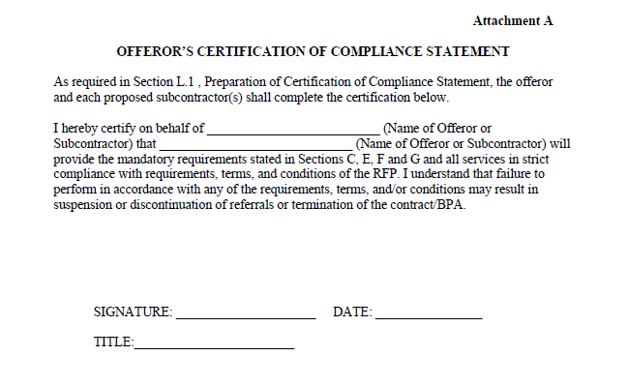

Slide 71
Statement of Work Section L cont.
Attachment B – Offeror’s Background Statement
Provide copies of all monitoring reports for the previous 18 months from federal, state and local agencies.
If a monitoring report for the previous 18 months is not available, a federal, state, and/or local certificate or letter indicating the vendor has a satisfactory or higher rating is acceptable.
To be considered technically acceptable a vendor must have received ratings of satisfactory or higher.
Monitoring reports for proposed subcontractors are not required; however, onsite evaluations will be individually performed for all subcontractors.

Slide 72
Statement of Work Section L cont.
Attachment B – Offeror’s Background Statement
State expressly each location at which the offeror and any proposed subcontractors intend to provide services in response to this solicitation.
Include copies of all applicable business and/or operating licenses as required by state and local laws and regulations.
Offerors are not required to provide copies of the aforementioned documentation for proposed subcontractors; however, the offeror is responsible for ensuring proposed subcontractors have all applicable business and/or operating licenses as required by state and local laws and regulation.

Slide 73
Statement of Work Section L cont.
Attachment B – Offeror’s Background Statement
Include copies of compliance with all federal, state and local fire, safety and health codes.
Offerors are not required to provide copies of the aforementioned documentation for proposed subcontractors; however, the offeror is responsible for ensuring that proposed subcontractors have appropriate documentation demonstrating compliance with all federal, state and local fire, safety and health codes.
The offeror warrants all information contained therein is correct and accurately reflects the offeror's ability to perform.

Slide 74
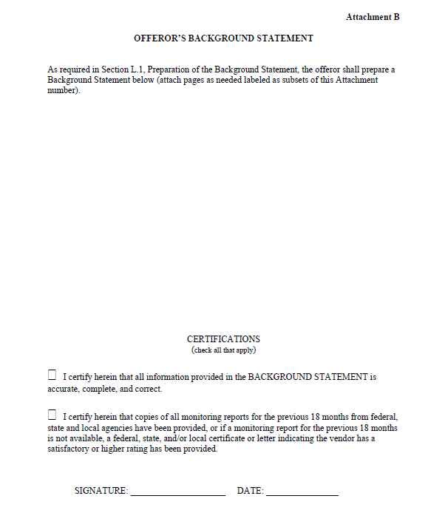

Slide 75
Statement of Work Section L cont.
Attachment C – Offeror’s Staff Qualifications
Complete for all proposed staff members and subcontractors.
Complete form/submit resumes, which includes the role of each staff member within your agency.
Certify staff members are not under investigation for or charged with a criminal offense and/or under any type of supervision within the local, state, or federal systems.
Certify staff members have not been convicted of any sexual offenses or are required under federal, state or local law to register on the Sexual Offender registry.
If responding to a sex offender treatment RFP, certify staff members adhere to ATSA’s ethics, standards, and practices.

Slide 76
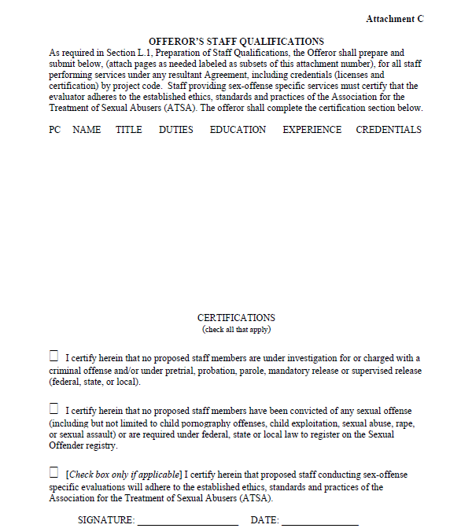

Slide 77
Statement of Work Section L cont.
Attachment D – Offeror References
Provide name, address, telephone number, and contact person of three references (federal, state or local government agencies and/or private organizations) your agency has provided similar treatment or other services to within the past 3 years

Slide 78
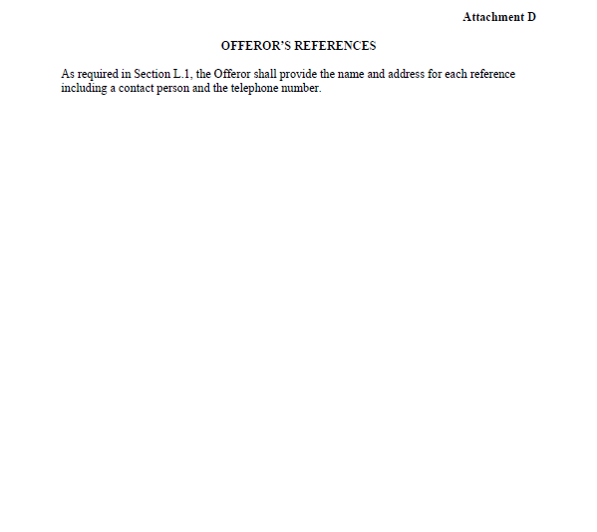

Slide 79
Statement of Work Section M
Evaluation Factors for Award
Basis for Award
Technically acceptable
Able to fulfill mandatory requirements found in Section C, E, F, and G
Lowest Price

Slide 80
Evaluation of Proposals
If the proposal is completed in accordance with instructions provided in Section B and L, it will be acceptable and eligible for evaluation.
A proposal is technically acceptable if it outlines how your agency will meet all mandatory requirements found in Section C (including Local Requirements), E, F, and G.
Pass/fail criteria is used when assessing the Offeror’s Technical Proposal (Certification of Compliance Statement, Background Statement, Staff Qualifications).

Slide 81
Evaluation of Price
Multiply the Estimated Monthly Quantities (EMQs) by 12 months to calculate Yearly Quantities.
Multiply Yearly Quantities by the Unit Price to get the Total Evaluated Price for the service item.
Add the Total Evaluated Price for each service item to arrive at the Offeror’s Total Evaluated Price.

Slide 82
On-Site Visits
Conducted if offeror’s proposal is found technically acceptable and if the offeror meets the lowest cost requirement.
Verifies offeror’s written proposal.
Subcontractor sites will be visited as well.

Slide 83
Important Dates/Reminders
Additional questions must be emailed to txnp_treatmentservices@txnp.uscourts.gov by 5:00 p.m. on Friday, July 23, 2022.
Responses to questions will be posted to TXN’s website www.txnp.uscourts.gov by Friday, August 6, 2022.
A separate proposal must be submitted in response to each BPA.
An original copy of Sections A, B, J, K, L, and M must be submitted to our Dallas office by 5 p.m. on Friday, August 13, 2022.
BPA awards will be made in mid to late-September 2022, and services will begin on October 1, 2022.

Slide 84
Questions?
Wayne McKim
Deputy Chief U.S. Probation Officer
Joseph Droege
William Cruz
Richard Cortinaz
Darwin Shaw
Dan Jones
Supervising U.S. Probation Officers
Tameka Adams
Administrative Services Supervisor
Karron Dailey
Administrative Specialist
Holly Christensen
Toni Thompson
Lisa Avent
Dale Rector
Jaime Espinosa
Scott Cannon
Lauren Flood
Chris Larremore
Bevan Vaughan
Senior U.S. Probation Officers
Juan Lopez
Jeannine Williams
U.S. Probation Officers
(Treatment Liaisons)

